Slide 1
Detection of a Fake Twitter accounts based on the minimally weighted range of Attributes
CMP7200 Individual Masters Project
Module Supervisor: Jagdev Bhogal
Module Leader: Mariam Adedoyin-Olowe
Submitted By:
Student Name: Naga Sai Ganesh Ronte
Student ID: 20110720

Slide 2
Agenda
Abstract
Introduction
Objective of the research
Literature Review
Data Methodology
Overview of other Methodologies
Conclusion
References

Slide 3
Abstract
Online Social Network (OSN) is an interconnected channel of networks for individuals with shared preferences or connections in the real world. If OSN's (Online Social Network) popularity grows, security and privacy concerns are also on the increase because the size of an audience, using that particular social media site is the basic reason of its fame and this has significant social and economic entanglement, which is complicated and exploited the true information about its population via the presence of unauthentic, unauthorized false and fake accounts.

Slide 4
Introduction
Twitter is the most famous operating system network out of all the OSN’s in the world. The users in the twitter can get entertainment & can share information via various features such as, tweeting, hash tagging & mentioning other users. Internet networking services like Twitter and Facebook draw thousands of people around the world and have affected their lives in interaction with social networking. This success of the networking of social networks has led to numerous issues, including the risk of revealing false knowledge to their users by means of fake profiles.

Slide 5
The growth in Twitter social exchanges recently brought cyber criminals to the focus. Spammers spread aggressive messages over Twitter, links of publish phishing and flooding of the network by fake and spam accounts.
The method of identifying the network of spammers involved in such operations is a censorious step in the detection of individual spam accounts. There are various methods for identification of spam and fake accounts, proposed by some legendary work of researchers.
To identify Twitter accounts as accurate or not, machine learning styles and harvesting approaches have been used. User profiles are explicitly generated in social honeypot strategies to attract spammers to gather information about their profile.

Slide 6
Aim
The aim is to detect false and clone Twitter profiles. Because Fake and replica accounts in online social networks have been a terrible issue. In daily life, we encounter any of the other risks from these accounts. Thus, A variety of laws are used to identify fraudulent and authentic profiles as applied for fake profile identification.

Slide 7
Objective
Our main objective is to devise a tool for the detection of fake accounts and for this purpose. Fake accounts are classified based on a sequence of guidelines that can distinguish false and true profiles efficiently. Two techniques will be used for profile identification—one with similarity and the other with the C.5 (five classification) algorithms for decision tree.
The weighted attributes will be sent forward to be applied 5 classification algorithms. The way to the application of C.5 (five classifications) algorithm will be started when the 22 attributes will filter from twenty-two to seven attributes with high results of accuracy. These attributes will be then used for the detection of fake profiles on twitter.

Slide 8
Literature Review
The research is basically on subject matters with the inside experience about bots but isn't especially applicable otherwise. However, it does include some beneficial statistics. The authors of this paper intend to speak about the effect of computerized Twitter bills that unfold research information. Below is the critical evaluation of the work of some authors.

Slide 9
In May 2019, Dr. Ponnurangam Kumaraguru (Chair), Dr Arun Balaji Buduru, and Dr. Siddhartha Asthana authors paper mainly aim to search the attributes of fake profiles and devise a tool such as machine learning based system to identify and detect the fake accounts.
Contribution: An attempt to: qualitative analysis of reported and unreported users. Observe the contrasting and similar traits. Determine the inconsistence traits of a user to be declared as fake. Devise a deep learning technique.
Data: A large sum of genuine accounts found in comparison with the scam and reported profiles. Profiles have been reported various times. Reasons of reporting was taken into consideration. Spam profiles found to be more active in spamming people in large number.
Methodology: Methodology of Feature Engineering was used, for the detection of fake profile of twitters. Using this methodology, a behavior of user has been identified and then the summary of all the information along with the affinity of the users towards other categories. Moreover, the information was further computed with different time slots to check its validation.
Conclusion: In this paper, the research towards the detection of fake profiles was conducted and unique characters of spammers and scammers have been identified. A detailed analysis was carried out toon both reported and unreported users and because of detailed work a successful auto encoder model was trained to solve the problem of fake accounts on online matrimony.
Critical Analysis: Model could only learn a limited distribution of normal behavior and any profile that deviates from the standard of uniqueness is considered as fake. Access to private conversation is falsified so a spam through messages cannot be detected.

Slide 10
In March 2020, Nitika Kadam, Harish Patidar authors paper mainly aim to identify the fake accounts and establish a tool by the detailed study of data mining and machine learning.
Contribution: A Major portion on which this research was conducted are
Spam or unsolicited post identification
Detection of bots
Detection of profile.
Data: Data was obtained from client server architecture in which is a sort of centralized online social networks and from P2p architecture which uses connectivity at a local level and supports communication
Methodology: The dataset used in this research follows the following flow, Firstly, they headed from social media platform to relevant API, then to data extraction, after this the data was processed and profiled because of which the content and attributes were obtained, this led them to score the content and then decision making was upheld.
Conclusion: The research paper concludes that the fake profiles are classified accurately using a new model formed based on data mining and machine learning techniques and to detect the fake user’s data extraction technique was used.
Critical Analysis: Limitations to this paper was the usage of client server architecture which on one hand if provides easy implementation and management on the other hand also led to the network failure and blockage of communication if at a single point is affected by false management.

Slide 11
In Jan 2020, Dr. K. Sreenivasa Rao, Dr.G. Sreeram, and DR. B. Deevena Raju authors paper mainly aim to detect the malicious & fake accounts that leads to the misinformation and agenda creation for people.
Contribution: The major section on which this research paper is based are
Support vector Machine
Random forest
Neural Networks
Data: Sarah Khaled et al. introduced a novel algorithm, SVM-NN for detecting bogus Twitter accounts and bots, as well as feature selection and dimension reduction strategies. This suggested technique (SVM-NN) employs fewer characteristics while successfully classifying around 98 percent of the accounts in our training dataset.
Methodology: Following methodology is used, for the detection of fake profile of twitters. This methodology follows this sequence i.e., gather data from accounts and cleaning them Creation of accounts that are fictitious. Validation of data that is extracted Creation of modern and new feature Usage of machine algorithms that are supervised Evaluation of results
Conclusion: This paper has provided a Machine Learning pipeline for identifying bogus accounts in online social networks. Our examination of Support Vector Machine, Random Forest, and Neural Networks demonstrated good performance, with the accuracy of prediction appearing to be greater utilizing Support Vector Machine for the provided dataset. For a particular data set, the accuracy of detecting bogus accounts is shown to be greater when utilizing the Random Forest Algorithm, followed by the Neural Networks Algorithm.
Critical Analysis: No limitations has been observed. However Neural networks using recurrently for a better detection of fake accounts

Slide 12
Previous Work
Various research has been conducted to detect fallacies of the twitter accounts with various approaches. In this research the feature-based strategy of detection will be used, this strategy of detection will be monitored based on the behavior of the twitter user, or we can say the owner of a particular twitter profile who is running the twitter account.
The work has been already reached the high score of accuracy and the accuracy rate is almost up to 84.5%. In this work, the approach was initially held to detect faux accounts with up to 85% accuracy with the identification of 22 attributes.

Slide 13
Out of these 22 attributes 17 attributes were finalized, and out of 17 attributes 10 attributes were then proceeded for fake account detection.
However, I have already mentioned that the results obtained from this research are not much optimistic and can be taken for granted for the identification of fake accounts on twitter and fake users’ profile, and it’s not sure that the fake users’ profile detection or fake account detection by the help of graph algorithms, is going to give results with higher rate of accuracy with absolute correctness and preciseness.

Slide 14
Data Methodology
In this paper, we intend to successfully hit upon the fake accounts on the social community of Twitter with the viable minimal set of attributes. This proposed plan includes two fundamental steps:
To decide the primary elements that plays important role in an accurate detection of fake accounts.
To use a category in which there is defined a set of rules that makes use of the decided elements in the first step of an accurate detection of fake accounts.

Slide 15
A working plan to determine the required characteristics is gradually established various steps, a detailed plan is proposed below.
A survey has been carried out that described distinctive sets of features. wherein all the features were accumulated that are proposed via researchers.
The experiment was carried out from different angles. In the first experimental series, the five most successful classification algorithms are applied to the data set.
The algorithms then passed to the series of validation that held up to 5-times, and the consequences of the validation series then accomplished.
The selected attributes then subjected to further testing and minimized. And then being applied a Gain Measure on, to find the weight of them.
In the third step of experimentation, the calculated weight of the attributes again used to validate further five classification of algorithms & then again applied to the data set.
Again, the five-cross validation of the algorithms conducted and then results have been compared.

Slide 16
6. The Gain Measure again applied on the selected and minimized attributes.
7. By comparing the weight of all those attributes in the fourth step of experimentation, the five classification of algorithm again applied on the given dataset based on the selected attributes
8. Again, the five-cross validation of the algorithms conducted and then results have been compared.
9. In the beginning we had 22 attributes in total, which then testified and validated and then minimized to 19, now in the fifth step of experimentations, attributes are being further validated and scrutinized to 7 attributes. This was according to the weight of those attributes that had an equivalent to or above to 50%. And after this process and the 5-classification algorithm again subjected to the dataset.
10. After this the previous step of five cross validation of the algorithms repeated and then consequences have been compared.

Slide 17
12. In the sixth step of experimentations, we tend to repeat the step of using weight which was calculated for 19 attributes, 5 classification algorithm again subjected to the dataset, according to the weight of those attributes that had an equivalent to or above to 50% and this minimized the attributes from 7 to 6.
13. After this, again the previous step of five cross validation of the algorithms repeated and then consequences have been compared
14. The whole series of experiments lead us to collect the minimum and scrutinized set of attributes with high score of classification and the best algorithm were then selected, so that we could capture the unauthorized accounts of twitter.
15. The minimum set of attributes with maximum number of accuracy were reached and there is only 1% chance of failure, However the 99% chances shows that all the fakeness is going to be caught sooner or late.

Slide 18
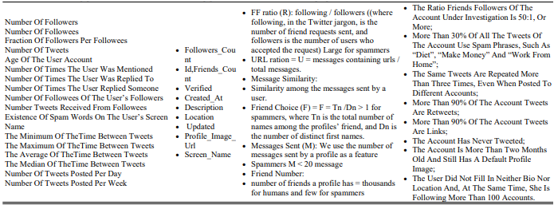
Accurate Detection of Unauthorized Twitter Accounts

Slide 19
Dataset
Experiments have been applied to the dataset of Fake twitter accounts. There was a project named as “The Fake project”. This project mainly consisted of the data of those accounts which were verified and the data of those accounts which were fake. The data collected from the Fake project was collected from a source. And the collected data consisted of the following information:
Verified accounts:
1481 verified accounts that belongs to humans, collected from #elzioni2013.
469 verified human accounts have been collected by the “Fake Project” team.
Fake accounts:
1000 fakes accounts from http://fastfollowerz.com, at price $19.
1000 from http://intertwitter.com, at price $14.
1000 fake accounts from http://twittertechnology.com, at price $13.

Slide 20
However, this table shows that the account that has followers less than 50, weighs up to 0.52, the geo-localized accounts and those accounts which are being added to favorites by other users weighs up to 0.86.
Those accounts which uses hashtags in at least one tweet or more, and the twitter account that has been logged in using an iPhone weighs almost up to 0.9 and something. Mentions used by twitter user has the greatest of all weights which is 1. The account that has tweeted at least 50 times, weighs 0.01.
Those users who have added at least one account into their favorites does weigh about 0.18. However, those profiles which contains a name, image, biography, URLs & physical address doesn’t count because they weigh 0.0.

Slide 21
Machine Learning
Five Binary Classification Algorithms are used:
Random Forest Classifier
Support Vector Machine
Multi-layer Perceptron
Bernoulli Naïve Bayes
Decision Tree
Performance Metrics used are:
Accuracy Score
F1-Score
Confusion Matrices

Slide 22
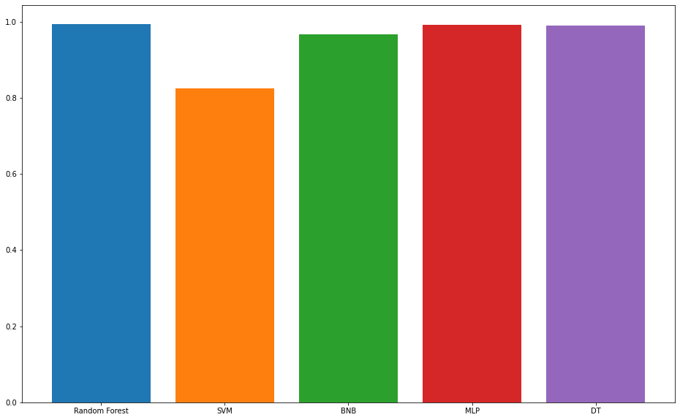
Results – Comparative Accuracy Score

Slide 23
Results – Accuracy Score Values
Random Forest Classifier Accuracy: 0.9940898345153665
Support Vector Classifier Accuracy: 0.8262411347517731
Bernoulli Naive Bayes Classifier Accuracy: 0.966903073286052
Multi-layer Perceptron Accuracy: 0.9929078014184397
Decision Tree Classifier Accuracy: 0.9905437352245863

Slide 24
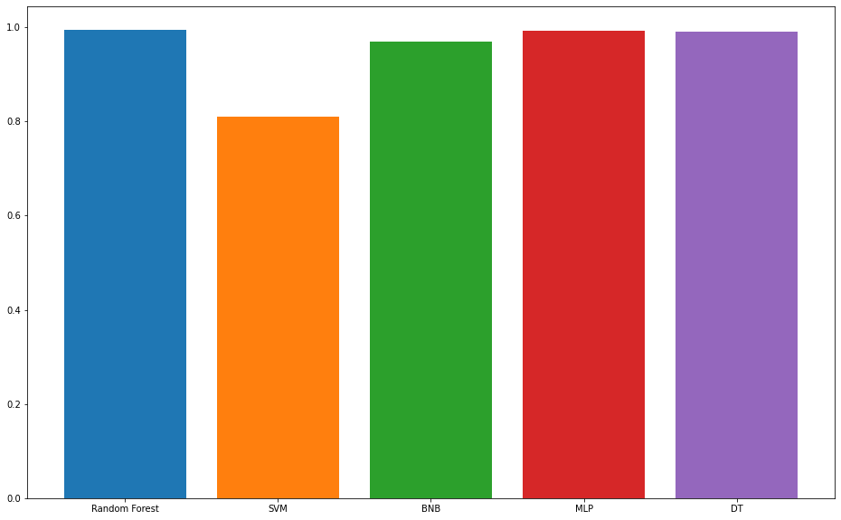
Results – Comparative F1 Score

Slide 25
Results – F1 Score Values
Random Forest Classifier F1-score: 0.994535519125683
Support Vector Classifier F1-score: 0.8093385214007782
Bernoulli Naive Bayes Classifier F1-score: 0.9689578713968958
Multi-layer Perceptron F1-score: 0.9934354485776805
Decision Tree Classifier F1-score: 0.9912280701754386

Slide 26
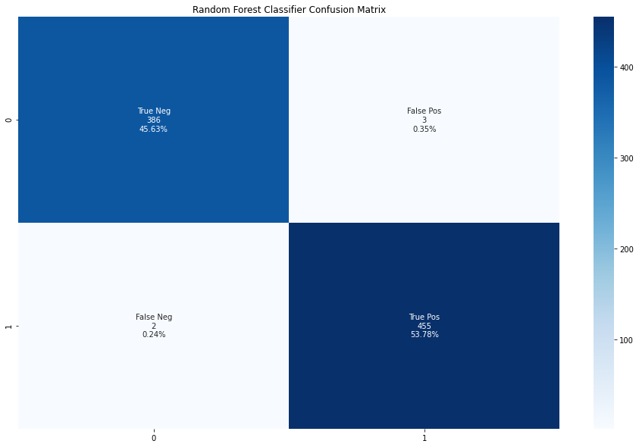
Results – Random Forest Classifier Confusion Matrix

Slide 27

Results – SVM Classifier Confusion Matrix

Slide 28
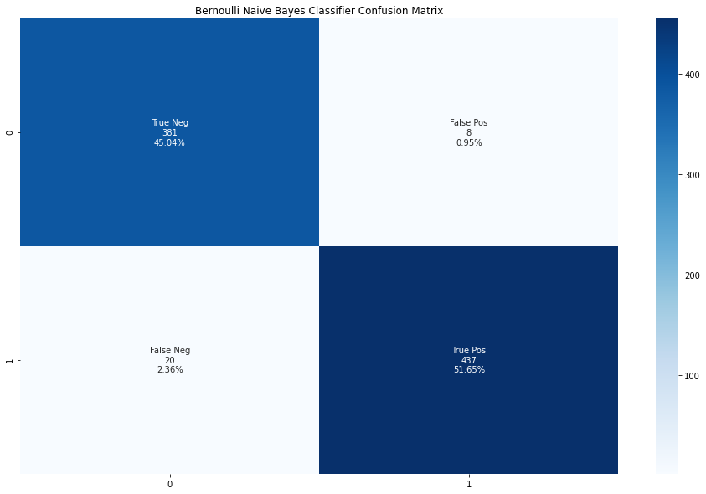
Results – Bernoulli Naïve Bayes Confusion Matrix

Slide 29

Results – MLP Confusion Matrix

Slide 30

Results – Decision Tree Classifier Confusion Matrix

Slide 31
Conclusion
In this research paper, we have proposed a methodology for the detection of fake profile that are being penetrating in twitter’s network, which is a site of social networking. The focus of the proposed approach was to identify the effective functionalities, that could help us in detecting the fake and unauthorized profiles. During this research, we collected 22 attributes which were then subject to the series of experimentations, testified and validated various time to collect the best ones and then minimized attributes were weighted. The weighted attributes were then sent forward to be applied 5 classification algorithms. The way to the application of C.5 (five classifications.) algorithm was started when the attributes were filtered to seven attributes with high results of accuracy. And then used for the detection of fake profiles.

Slide 32
Overview of other Methodologies
Detection of FAKE profile
Spammers proved to be very intellectual in this regard and as a response to this act, they used the perfect strategy of making authorized accounts, that were exactly similar and identical to the original ones, to avoid such detection and to be in their safe zone.
The availability of geographic information, the use of hashtags in tweets, etc. Fake Twitter accounts can be efficiently identified. Also, a controlled machine learning pipeline, which used to compare the frequency of text occurrences between functions such as names, emails, etc., and to identify twitter accounts as malicious or authorized.

Slide 33
Similarity measures for clone profile detection:
Although there are many differences in social networking sites, but still there is a common concept between them, that is, each user presents a unique entity for viewing, and has a constantly changing profile that provides its image and attribute list to every user in the online world.
As a result, an attacker can extract the information and doing an identity theft of the targeted profile in every other social community. In simple words, the feedback is the user profile. The profile extracts user identification information. Check for accounts with characteristics that complement the profile of the user. The Similarity Index is determined, and the profile is called clone if the Similarity Index exceeds the threshold, otherwise normal.

Slide 34
References
BRÓDKA, P., SOBAS, M. & JOHNSON, H. (2014) Profile cloning detection in social networks. European Network Intelligence Conference, 2014. IEEE, 63-68.
CHATTERJEE, M (2019) Detection of Fake and Cloned Profiles in Online Social Networks.
Dr. Ponnurangam Kumaraguru (Chair), Dr Arun Balaji Buduru, Dr. Siddhartha Asthana (2019) Detecting Fake Profiles on Online Matrimony.
Nitika Kadam, Harish Patidar (2020) Social Media Fake Profile Detection Technique Based on Attribute Estimation and Content Analysis Method.
CONTI, M., POOVENDRAN, R. & SECCHIERO, M (2012) Fakebook: Detecting fake profiles in online social networks. IEEE/ACM International Conference on Advances in Social Networks Analysis and Mining, 2012. IEEE, 1071-1078. International Journal of Control and Automation. 13, No. 1s, (2020), pp. 95-10095ISSN: 2005-4297IJCACopyright ⓒ2020SERSCDETECTING FAKE ACCOUNT ON SOCIAL MEDIA USING MACHINE LEARNING ALGORITHMS1, Jan,2020

Slide 35
CRESCI, S., DI PIETRO, R., PETROCCHI, M., SPOGNARDI, A. & TESCONI, M. 2015. Fame for sale: Efficient detection of fake Twitter followers. Decision Support Systems, 80, 56-71.
DEVMANE, M. & RANA, N (2014) Detection, and prevention of profile cloning in online social networks. International Conference on Recent Advances and Innovations in Engineering (ICRAIE-2014) IEEE, 1-5.
ELAZAB, A. 2016. Fake accounts detection in twitter based on minimum weighted feature. World.
ELAZAB, A. & MAHMOUD, M. 2018. Fraud news detection for online social networks. Artif Intell Syst Mach Learn, 10, 177-182.
ERŞAHIN, B., AKTAŞ, Ö., KıLıNÇ, D. & AKYOL, C (2017) Twitter fake account detection. 2017 International Conference on Computer Science and Engineering (UBMK). IEEE, 388-392.
FIRE, M., GOLDSCHMIDT, R. & ELOVICI, Y. 2014. Online social networks: threats and solutions. IEEE Communications Surveys & Tutorials, 16, 2019-2036.
GRIER, C., THOMAS, K., PAXSON, V. & ZHANG, M (2010). @ spam: the underground on 140 characters or less. Proceedings of the 17th ACM conference on Computer and communications security. 27-37.
GUPTA, A. & KAUSHAL (2017), R. Towards detecting fake user accounts in Facebook. 2017 ISEA Asia Security and Privacy (ISEASP). IEEE, 1-6.

Slide 36
Thank You!!

